Slide 1
Data Leakage
Pravin Y Pawar
Largely adapted from Machine Learning Engineering
By Andriy Burkov

Slide 2
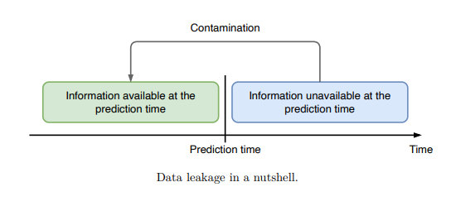
Data Leakage
Data leakage, also called target leakage,
a problem affecting several stages of the
machine learning life cycle, from data
collection to model evaluation
Data leakage in supervised learning is the
unintentional introduction of information about the
target that should not be made available
also called as “contamination”
Training on contaminated data leads to overly
optimistic expectations about the model performance

Slide 3
Causes of Data Leakage
Three most frequent causes of data leakage that can happen during data collection and preparation:
target being a function of a feature,
feature hiding the target,
feature coming from the future

Slide 4
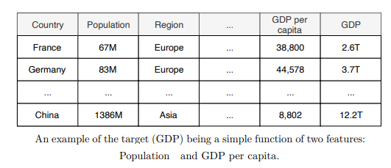
Target being a function of a feature
Example
Let goal be to predict a country’s GDP based on various attributes:
area, population, geographic region, and so on
Gross Domestic Product (GDP) is defined as the monetary measure of all
finished goods and services in a country within a specific period
If you don’t do a careful analysis of each attribute and its relation to GDP, you
might let a leakage happen:
two columns, Population and GDP per capita, multiplied, equal GDP
The model will perfectly predict GDP by looking at these two columns only
The fact that GDP be one of the features, though in a slightly modified form
(devised by the population), constitutes contamination and, therefore, leads to
data leakage
Imagine training a model to predict the yearly salary, given the attributes of an
employee
The training data is a table that contains both monthly and yearly salary,
among many other attributes
If monthly salary is not removed from the list of features, that attribute alone
will perfectly predict the yearly salary,
making believe that model is perfect
Once the model is put in production, it will likely stop receiving information
about a person’s monthly salary: otherwise, the modeling would not be needed

Slide 5
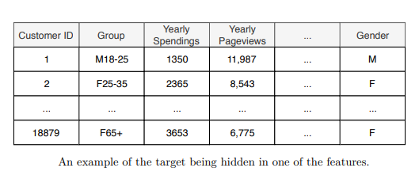
Feature hiding the target
Sometimes the target is not a function of one or more
features, but rather is “hidden” in one of the features.
Using customer data to predict their gender
Look at the column Group
If you closely investigate the data in the column Group,
represents a demographic value to which each existing
customer was related in the past.
If the data about a customer’s gender and age is factual, then
the column Group constitutes a form of data leakage
the value want to predict is “hidden” in the value of a feature
On the other hand, if the Group values are predictions provided by another, possibly less accurate model
then it can be used to build a potentially stronger model - model stacking

Slide 6
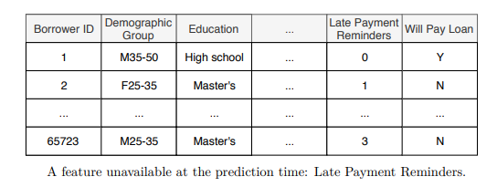
Feature coming from the future
Feature from the future is a kind of data leakage that is hard to catch
if don’t have a clear understanding of the business goal
Imagine a client asked to train a model that predicts whether a borrower will
pay back the loan
based on attributes such as age, gender, education, salary, marital status, and so on
might decide to use all available attributes to predict the value in the column Will Pay
Loan, including the data from the column Late Payment Reminders
Model will look accurate at testing time and model doesn’t work well in the
production environment
in the production environment, the value of Late Payment Reminders is always zero
makes sense because the client uses model before the borrower gets the credit, so no
reminders have yet been made!
However, model most likely learned to make the “No” prediction when
Late Payment Reminders is 1 or more and pays less attention to the other
features
Understanding the business context in which the model will be used is, thus, crucial to
avoid data leakage.

Slide 7
Thank You!
In our next session:

